Slide 1

Comparison of Opioid Related Deaths in Coastal States
by Francesco D’Anselmi

Slide 2
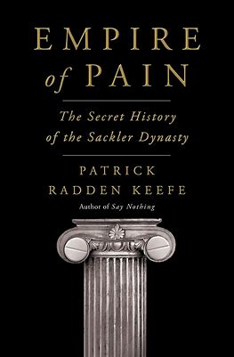
Inspiration for this topic.
Empire of Pain by Patrick R. Keefe
Doctors and health care providers where given a lot of false and were misled by pharmaceutical companies.
These opioid were much more addictive and harmful then the medical community thought.

Slide 3
Quick facts about the opioid epidemic in America
Opioids are most often used medically to relieve pain. Opioids include opiates, an older term that refers to such drugs derived from opium, including morphine itself. Other opioids are semi-synthetic and synthetic drugs such as hydrocodone, oxycodone and fentanyl
More than 760,000 people have died since 1999 from a opiate drug overdose.
75% of drug related deaths have been from opioids
According to the department of health and human services, in 2019, 10.1 million people misused their prescription.

Slide 4

The data set I found.
This data was compiled using the CDC's WONDER database.
Shows data from 1999-2014 including:
State specific data
Deaths due to opioid overdose
Prescriptions dispensed each state

Slide 5
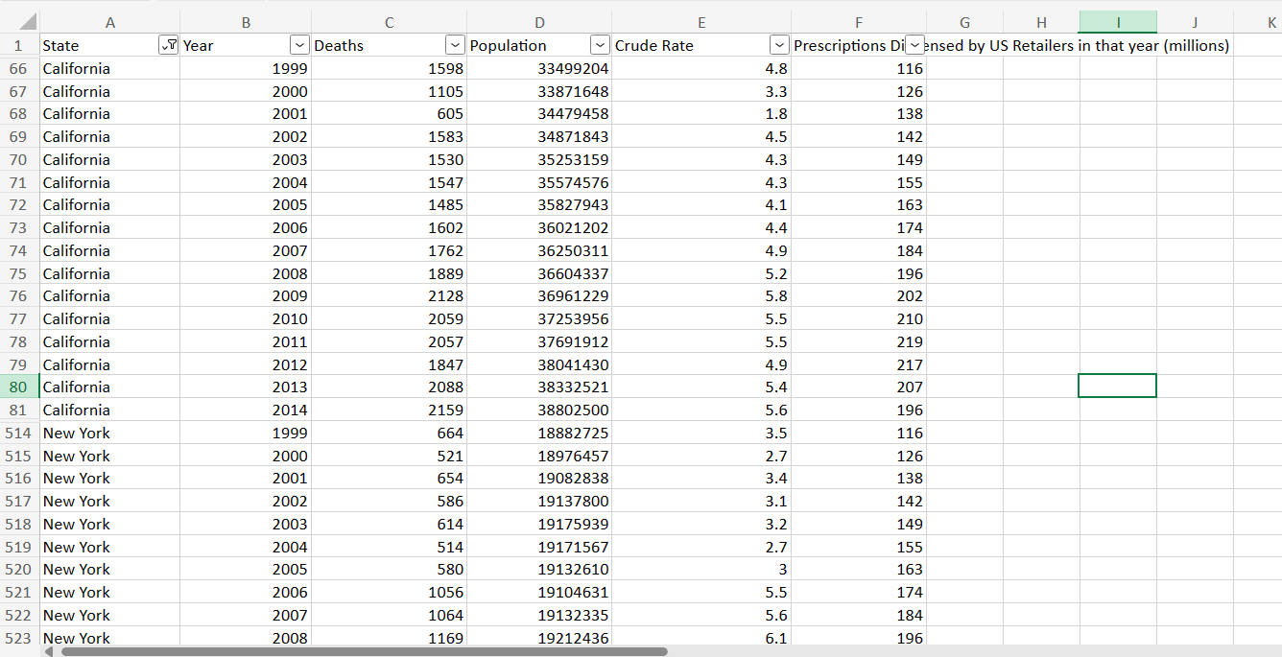
I decided to reduce the data to a comparison of two states
California
New York
Reasons
I am from New York
Similar geoeconomics and distribution.
Similar coastal states but also very far apart.

Slide 6
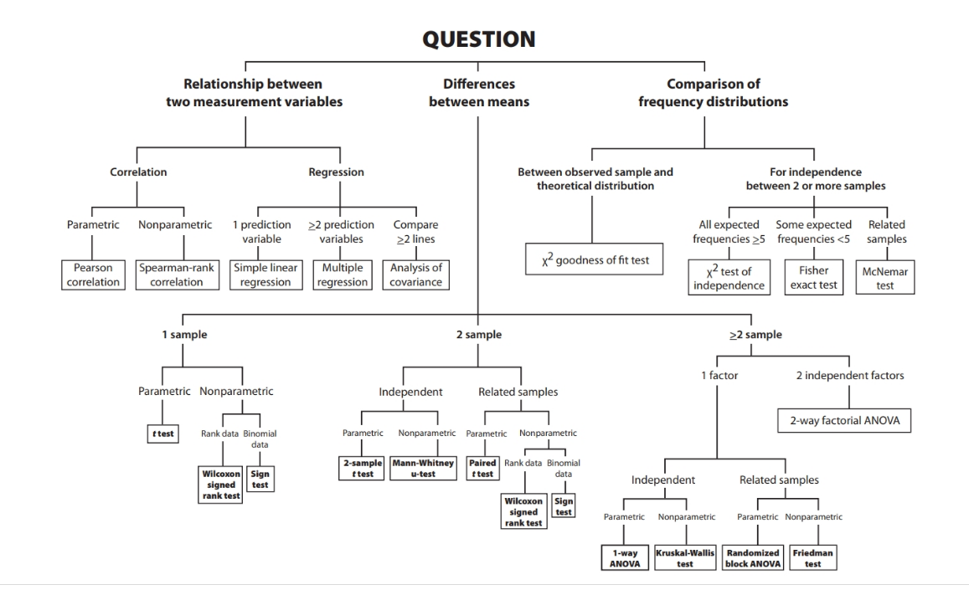

Slide 7
Hypothesis for Correlation Analysis
Null hypothesis: there is no association between death and prescriptions dispensed in both New York and California.
Alternative hypothesis: There is an association between death and prescriptions dispensed in both New York and California

Slide 8


California Correlation
Pearson's Correlation Rule
+1- 0 → positive correlation
0 → no correlation, reject null hypothesis
0 - -1 → negative correlation
→ positive correlation, reject null.
New York Correlation
→ positive correlation, reject null

Slide 9
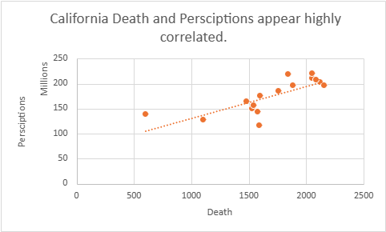
Correlation Graphs:

Slide 10
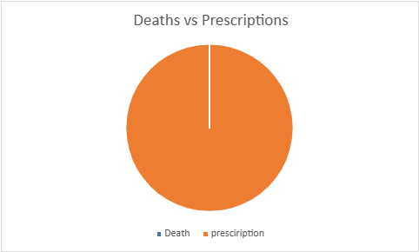
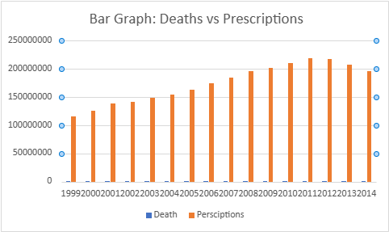
The way it was, the data was difficult to represent graphically.

Slide 11
Comparing the two states with each other
I converted the data into Crude Rates which is a simpler way to show how much an event is occurring.
= (Total number of Events (deaths) / Total Persons in Population) x Constant
The constant is for health rates is a multiple of 10, for this data it was 100,000

Slide 12
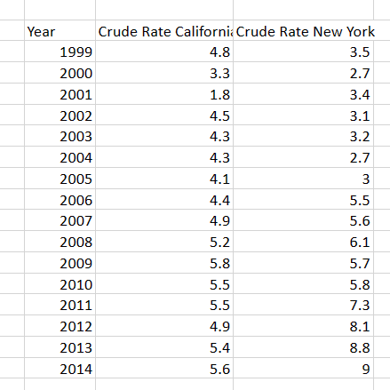
Converting my data into this format made it easier to compare each state - consolidating death and population into one data point.

Slide 13
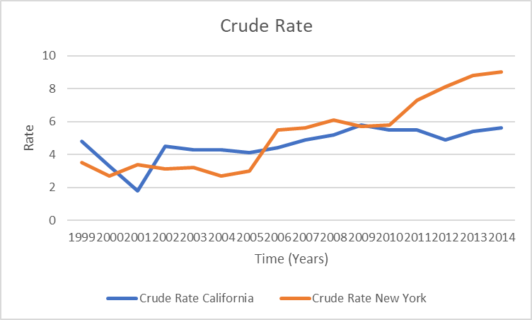

Slide 14
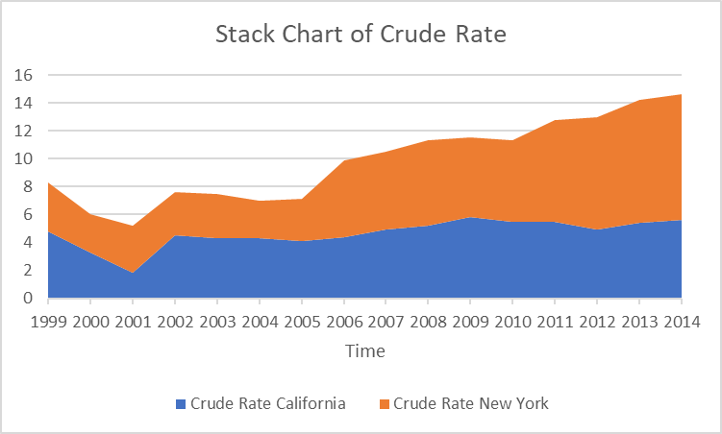

Slide 15
Now I wanted to compare the rate between the two states.
To do this, I consulted my flow chart once again. . .

Slide 16
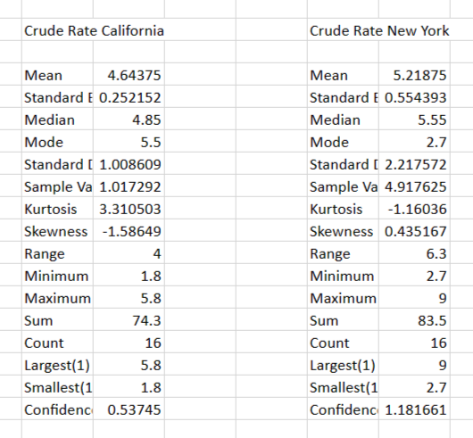
Descriptive Statistics
Means were fairly similar
Sample Variances were varied.
This meant I needed to run a t-test assuming unequal variance.

Slide 17
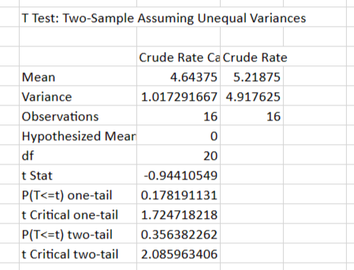
Comparing the two tailed p value of 0.356 to table value of 0.05
0.356 > 0.05
This mean we reject the null hypothesis of this test . . .
There is a significant difference between the crude rate of New York and California

Slide 18
Conclusions:
There is an association between opioid related deaths and prescriptions administered.
This test does not imply that that more prescriptions directly cause these death.
The cause, rather can be attributed to other things such as lack of medication understanding, pharmaceutical driven misinformation.
There is a significant difference in the crude rate between New York and California.

Slide 19
Thank you!

